Slide 1
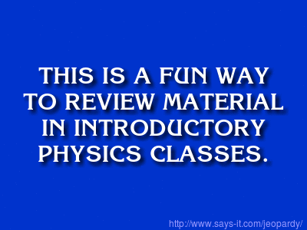
What are Jeopardy! Review Sessions?
David Dixon
Saddleback College
(Orange County, California)
AAPT Winter Meeting
January 12, 2016

Slide 2
question display
(PowerPoint)
game board
scoreboard
(room SM 102, Saddleback College, December 8, 2015)

Slide 3
Requirements
class size < 30
teams of 3–5 students
no buzzer system needed
overhead projector
each round = 25 questions
(5 categories, 5 questions each)
= 1 hour
open book, open notes (but no internet!)
visible clock: teams have a limited amount of time to answer each question

Slide 4
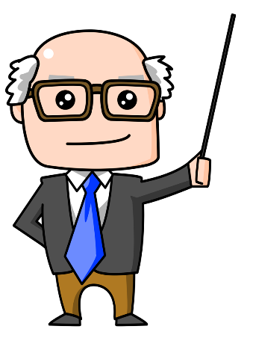
Playing the game
Host
Team 1
Team 2
Teams take turns choosing questions from the game board
(Team 1 picks the first question, Team 2 picks the second question, etc.)
Teams may either answer or pass.
If they answer correctly, they win points.
If they answer incorrectly, they lose points and the next team can answer.
If they pass, their score is unaffected, and the next team can answer.

Slide 5
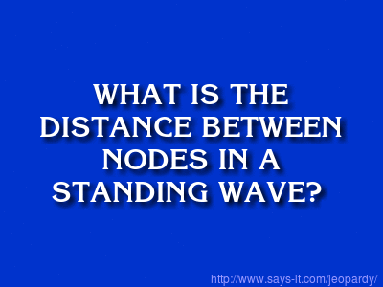
Gameplay examples
correct answer
Team 1: please choose the first question.
“Waves and Sound” for 100.
You have 30 seconds.
Half a wavelength.
Correct for 100 points!
Team 2: pick the next question.

Slide 6
Gameplay examples
incorrect answer
You have 30 seconds.
One wavelength
Incorrect! You lose 100 points. Team 2: you have 15 seconds to steal.
opposing teams get half the time
Half a wavelength
Correct for 100 points.
Team 2: pick the next question.

Slide 7
Gameplay examples
pass
You have 30 seconds.
We’re not sure. Pass.
Team 2: you have 15 seconds to steal.
We’re not sure either. Pass.
The answer is “half a wavelength.”
Team 2: pick the next question.

Slide 8
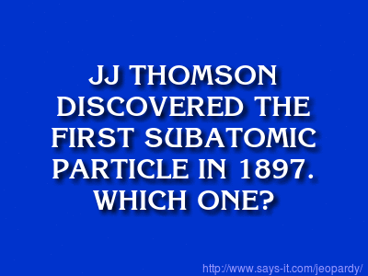
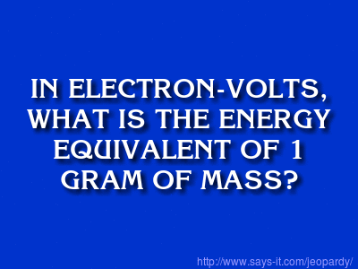
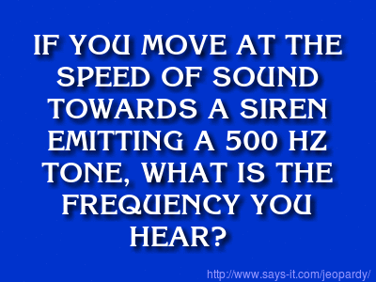
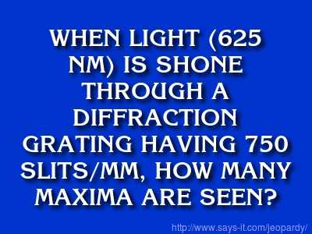
Questions
http://www.says-it.com/jeopardy
Factual recall (30 seconds)
Short calculation (1 minute)
Long calculation (2 minutes)
DAILY DOUBLE (3 minutes)

Slide 9
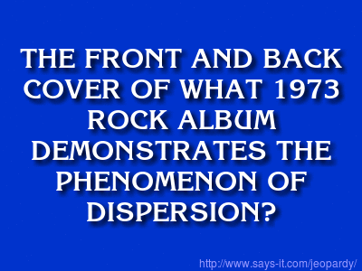
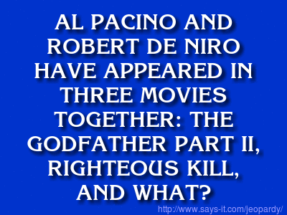
Optional: non-physics questions
Dark Side of the Moon
Heat

Slide 10
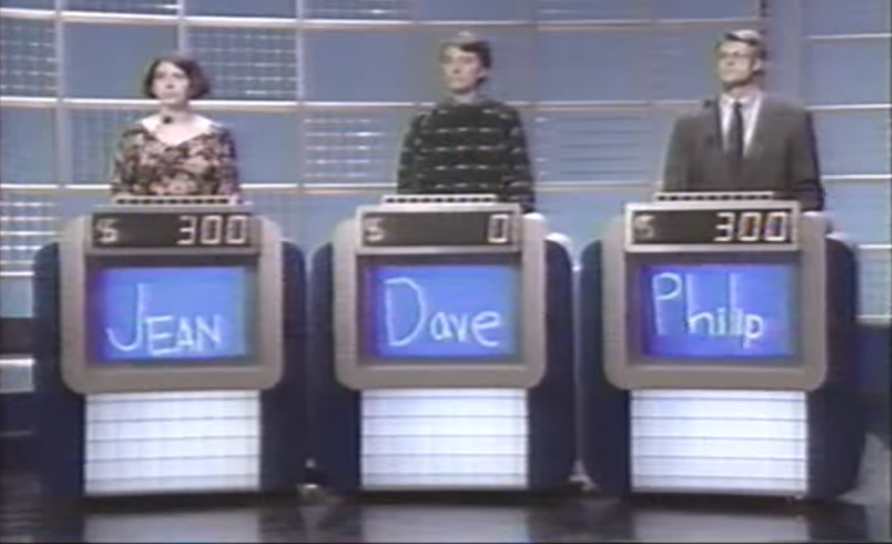
Optional: show your own appearance on Jeopardy!

Slide 11
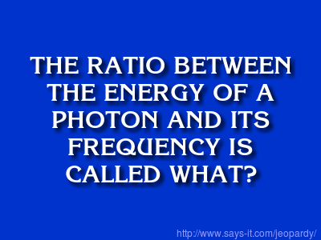
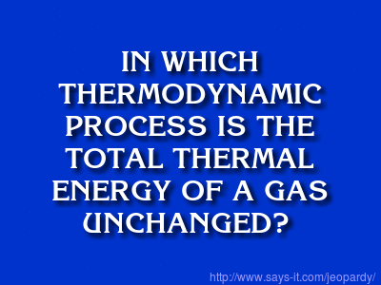
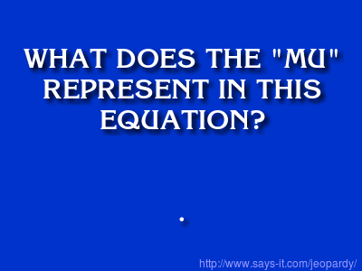
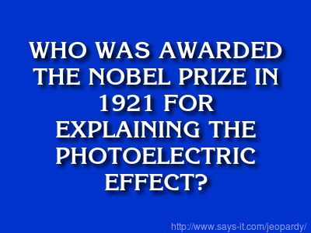
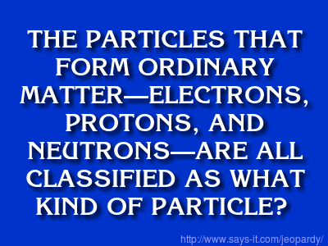
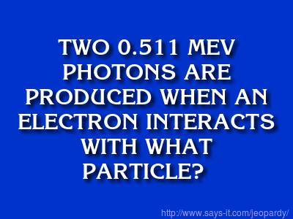
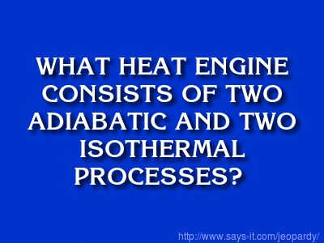
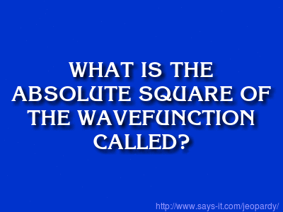
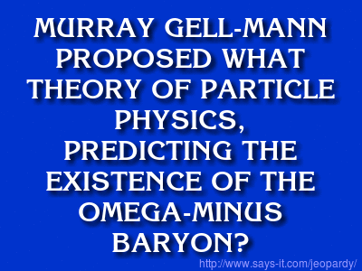
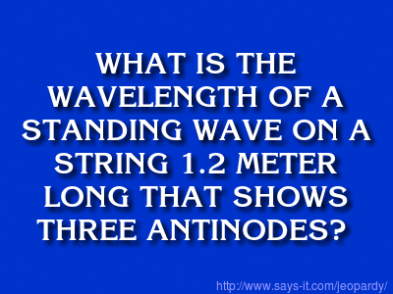
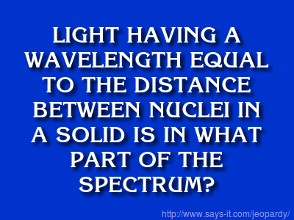
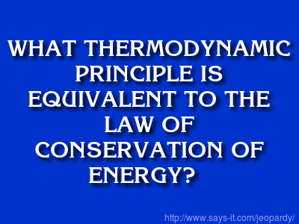
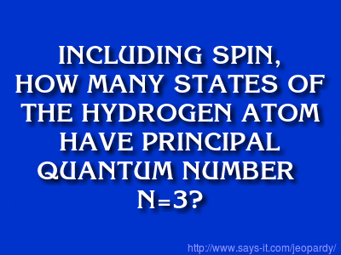
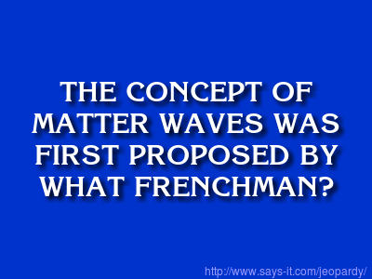
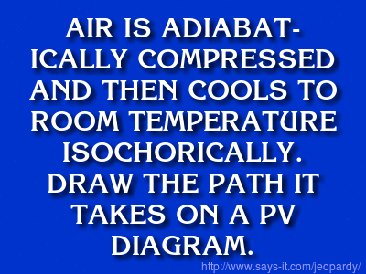
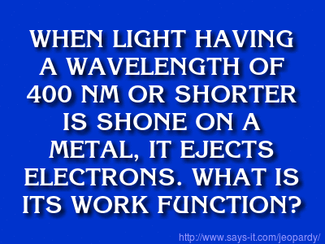
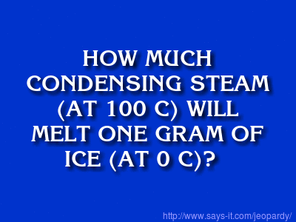
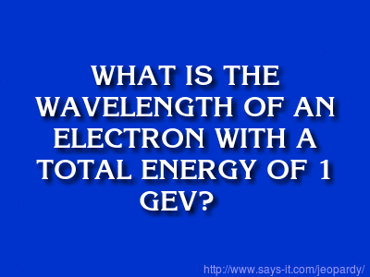
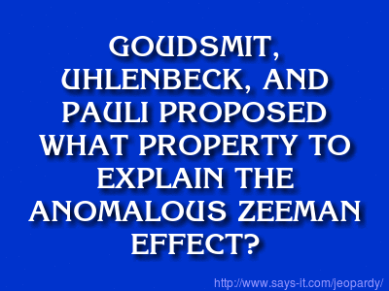
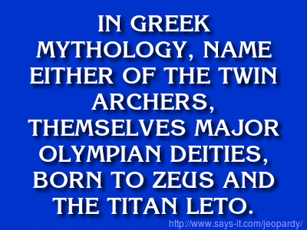
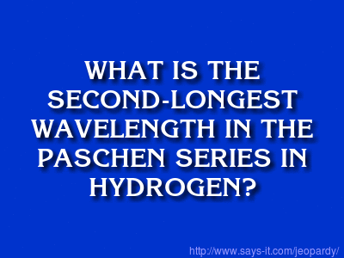
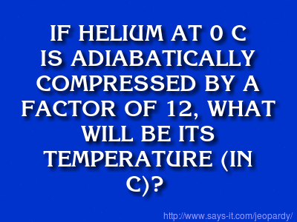
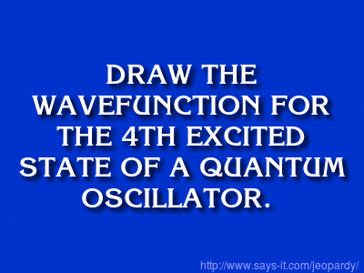
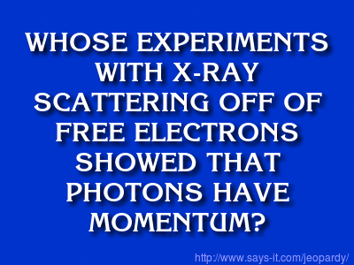
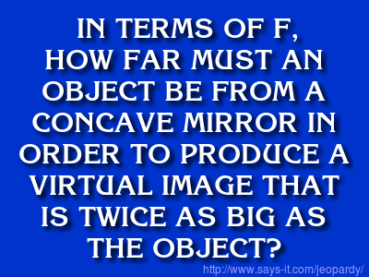
Sample rounds available upon request: ddixon@saddleback.edu
PHOTONS AND ATOMS
THERMODYNAMICS
QUANTUM
MECHANICS
PHYSICISTS
POTPOURRI

